Slide 1
Ethics in Economics
Paulina Osuch, Julia Osuch
Powiślański University

Slide 3
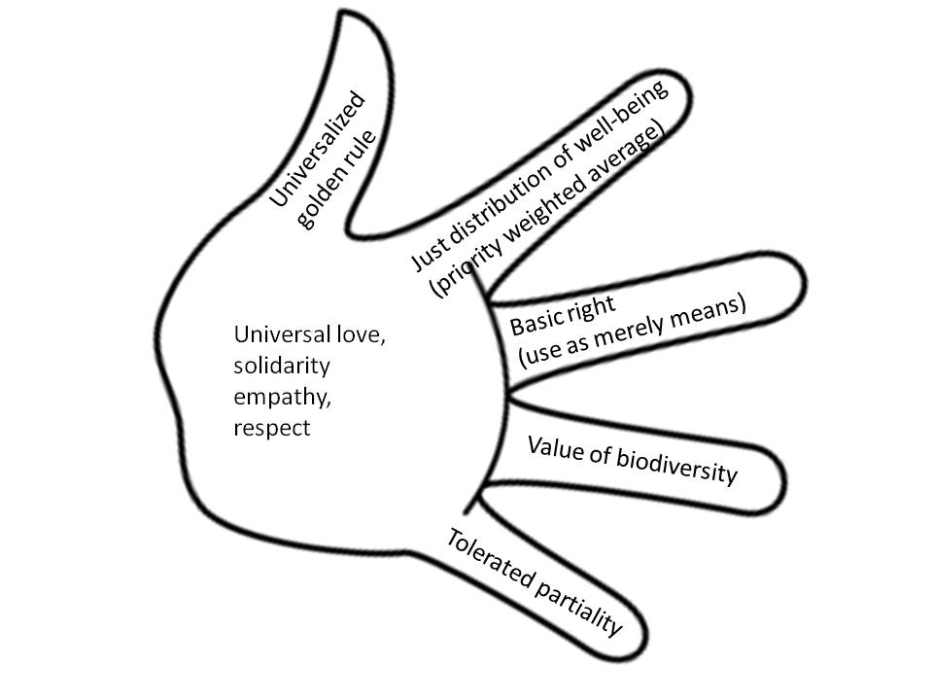
Golden rule – ethical precept
Golden Rule, precept in the Gospel of Matthew (7:12):
“In everything, do to others what you would have them do to you.
This rule of conduct is a summary of the Christian’s duty to his neighbour and states a fundamental ethical principle.

Slide 4
Golden rule – savings rate
Golden Rule savings rate is the rate of savings which maximizes steady state level or growth of consumption
The term is generally attributed to Edmund Phelps who wrote in 1961 that the golden rule "do unto others as you would have them do unto you" could be applied inter-generationally inside the model to arrive at some form of "optimum", or put simply "do unto future generations as we hope previous generations did unto us."

Slide 5
Ethics, equity and economics
Ethics - theories of “justice”
- medical versus economic polarisation
Equity - definitions
- “health”, “need” and “access vs. use”
- micro versus macro
Economics - equity and efficiency

Slide 6
Ethical theories
Utilitarianism
Rawlsian
Entitlement/libertarian
Egalitarian
Deontological
Virtue
“Rights”

Slide 8
Utilitarianism
Jeremy Bentham (classic) and John Stuart Mill (adapted)
‘Maximising greatest ‘utility’ for greatest number’
Underlies ‘efficiency’
Issues - domain (whose utility)
- malevolence (utility from suffering)
https://study.com/academy/lesson/what-is-utilitarianism-definition-theory-quiz.html

Slide 9
Veil of Ignorance – John Rawls
John Rawls 1971
Allocation conducted under ‘veil of ignorance’ - leads to position of less well off in society being maximised
Issues - assumes total risk averseness
- ‘bottomless pit’ argument
https://ethicsunwrapped.utexas.edu/glossary/veil-of-ignorance

Slide 10
Entitlement/libertarian
Robert Nozick 1974
Individuals ‘entitled’ to what they have acquired ‘justly’ i.e. within a market situation
Stresses freedom of choice and property rights - minimal state involvement
Similar to utilitarianism
https://www.youtube.com/watch?v=H0CTHVCkm90

Slide 11
Egalitarian
Equal shares in the distribution of a commodity
Issues - of what? health, services?
- according to what criteria?
‘need’, age?
https://www.youtube.com/watch?v=P4GaYpXRjMg

Slide 12
Deontological (deon (Gk) = duty)
Immanuel Kant
Moral ‘rules’ of how to live which should not be broken (ie absolute moral code)
‘Do to others as you would have done to you’
Humans as end, not means
https://www.youtube.com/watch?v=qMCeaXyrl7k
https://study.com/academy/lesson/deontology-definition-theory-ethics-examples.html

Slide 13
Virtue theory
Not ‘what should I do’ but ‘what kind of person should I be’
Similar to deontological - absolute moral ‘rules’
https://www.youtube.com/watch?v=JPV2KsWMRfc

Slide 14
‘Rights’ based theories
Unassailable ‘rights’ which cannot be overridden e.g.’right’ to life
Underlies ‘social contract’ theory
Absolute – inflexible
Utilitarism versus Rights based theories ?
https://www.youtube.com/watch?v=D6KIyOxl2yo

